Slide 1
QA to QE Transition

Slide 2











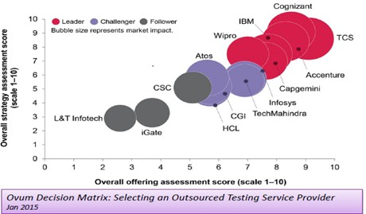
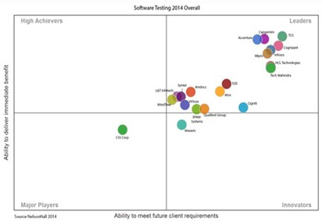
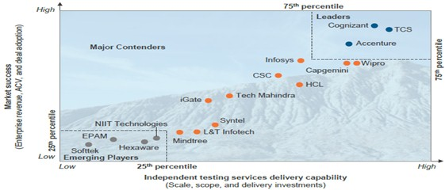






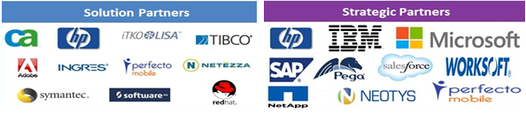





TCS Testing Capabilities
520+
Customers
across the Globe
8.6%
TCS Revenue
32000+
Strong Test Experts
across the Globe
7000+
Digital
Test Engineers
100+
Test Center of Excellence
56+
Test Accelerators
28+
Patents filed
50+
Digital Labs
Industry Recognition
Attested By
Testing Alliances and Proven Records
Recognized as “LEADER” in Decision Matrix on Outsourced Testing Vendor
LEADING VENDOR Award by TESTA For Assurance Services in UK and Europe
Recognized as “LEADER” in magic quadrant for application testing services
EXCELLENCE IN FRAMEWORK DESIGN AND IMPLEMENTATION AWARD by ATI for TCS’ reusable testing framework
HP – Best COE of the Year Award
IBM – Beacon Award
INFORMATICA – Partner of the Year Award
INFORMATICA – Innovation Award
ATI – QA Framework Excellence Award
CA Technologies – Enterprise Solution Award
Recognized as “LEADER” in Peak Matrix on Independent Testing Services
INNOVATION AWARD PARTNER by Informatica for TCS’ Test Data Management solution

Slide 3
IT Disruption
Objectives
Time to Market
Cost Reduction
Quality Improvement
Increase Predictability
Point of Departure
Solution Levers
Point of Arrival
Traditional QA
Technical QE team
Reduction in test cycles
Regression test Automation
Agile Adoption
QA to QE Transformation
Guardian for Customer Experience
Waterfall methodology
Quality Assurance as a Value Center
Higher QA/IT Cost
Innovation & Continuous Improvement
DevOps maturity
Digitization
Reduction in COQ
Guardian of functionality
Increase in test cycles
Tenets
Future Ready Test Organization
Service
Virtualization
Digital dashboards & Metrics
Dev Ops & CI/CD
E2E Automation
Smart Teams & Tools

Slide 4
Roadmap | QA to QE
QA Tester
Dev Team
Build Team
QA Tester
Requirement Analysis
Coding
Version Control
Maintenance
Unit Testing
Code coverage
Code Movement
Build Deployment
Functional Testing
Regression Testing
Integration Testing
Mature
QA Team
Develop End to End scripts
Measure DevOps maturity
Adapt new frames like DDD
Create Code driven testing
Plan
Feasibility
Automate
Test
Implement
Requirement Analysis
Automation Feasibility
Identify tools
Identify reuse components
Build/Customize Framework
Record/Script Functional Testing
Customize the scripts and Execute
Check –in Code to code repository
Verify test results and generate report
QE Team
Pilot
Based on business priority implement the transformation for other assets
Create reusable components
Develop framework for automation, DevOps and SV
Quality Engineer
Dev Team
Quality Engineer
Shift Left for QE
Learn
Identify tooling strategy & toolset
Identify asset for Pilot
Implement POV
Build, measure and publish metrics, digital dashboards
BENEFITS
QA team will own the end to end testing process
Early Defect identification
QA will be enabled effectively through out the SDLC life cycle
Smoke testing will be enabled for Bug free code deployment
Static testing will be enable for Requirements
End to End Automated Process
Upskill QA (Automation, SV, DevOps)
Create a Smart Team
Assign Mentors
Analysis AS IS state & create roadmap/stories

Slide 5
Key Initiative
Quality Engineering involves a set of Quality Assurance practices deploying state of the art techniques and tools to achieve desirable outcomes at each phase of Software Development Life Cycle (SDLC) by engaging QA.
Test Automation
Script less Automation
(UFT, Eggplant, Selenium & DevTest)
Enterprise Dashboard
Service Virtualization
Continuous Integration initiative in all Assets (Jenkins/Cloud-bees)
Static Code Analysis (SonarQube/Fortify)
DevOps
Virtual Service for Developers
(DevTest)
Service Catalogue for Enterprise usage
Unit Test Automation (jUnit, Cucumber)
Environment Monitoring
Private Cloud environment for QA
In-Sprint Automation
(UFT, Selenium, Eggplant, DVO & DevTest)
Enable ITS Tool for Automation
Automated E2E Workflow Testing
(QTP, Selenium, Eggplant, DVO, DevTest)
Tool Independent Frameworks
(UFT & Selenium )
Autonomation with new Open source tools (Sikuli & Renorex)
Custom template/framework for Java & .NET stack application
Automated Smoke Test and Regression Scripts pipelined with Development CI Jobs
Binary Code Artifact Management Assets (Nexus)
Automated Deployments using uDeploy
Functional QA Process
Build Regression Test Strategy
Maintain reusable test data repository
Promote lean testing
Bi-directional traceability metrics
Feasibility study for implementing Structural quality analysis using tools such as CAST SQG
Model based test design
Static testing of requirement documents

Slide 6
Competency Scale | Quality Engineer
Beginner
Intermediate
Expert
Test Automation
Awareness on any/all of the following Test Automation concepts:
Overall automation Testing concepts, process and methodology
Types of test automation ,Automation frameworks
Automation tools - HP QTP, Selenium, Eggplant etc.
Hands on experience in any/all of the following :
Feasibility analysis, automation estimation and ROI calculation
Test automation design, scripts development and troubleshooting
Creation of automation regression suite in any technology - Mainframe application, Web based application, client/server application, packaged application
Performed one or more test automation with fair amount of working knowledge on any/all of the following :
Standard automation tools and open source tools
Automation tools and frameworks like RAFT, SCEGEN, BVT, Testify, Test coverage Analyzer, Musketeers etc.
Tool evaluation , feasibility study, strategy preparation
Service Virtualization
Awareness on any/all of the following virtualization concepts:
Basic concepts of service virtualization and it’s benefits
Standard protocol
Soap XML, HTML, MQ/JMS, JDBC
Web services, Rest services, PL /SQL
EAI concept and middleware products from Vendors like TIBCO, Oracle, IBM etc.
Hands on experience in any/all of the following :
Tools implementation, configuration and virtualization of different types of services/protocols e.g. Web services, Rest, JDBC, JMS
Design of a virtual service and adoption of best practices on deployment and hosting of virtual services.
Performed one or more service virtualizations with fair amount of working knowledge on any/all of the following :
Guidelines and best processes for service virtualization implementation
Customize existing virtualization for reuse
DevOps
Awareness on the DevOps concepts:
Concepts of DevOps
DevOps culture
Lifecycle
DevOps tools
Hands on experience in any/all of the following :
Hands-on experience in any of the tools for continuous build , validation monitoring and feedback, Source Code Management, Continuous Integration, Build Management, Artifact Management and Deployment
Performed one or more DevOps implementation with fair amount of working knowledge on any/all of the following :
Participated in bringing culture shift within projects through DevOps adoption
Establishing tools & techniques for DevOps
Familiar with Tools across different stages in Project lifecycle.

Slide 7
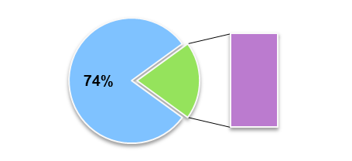
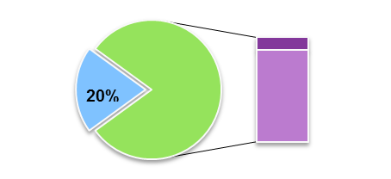
Case Study | US Large Payer
TCS in collaboration with “US Large Payer” envisioned to transform traditional Quality Assurance team to Quality Engineers by devising a comprehensive training plan and roadmap with achievable targets.
10% - New Talents from TCS Pool
26%
100% - Existing Team
QA
80%
QE
QA
90% - Existing Team
QA
QE
Test Automation – 16%
Test Automation
Test Automation
Test Automation – 40%
QE 26% to QE 80%
Current State
Future State
DevOps
Service Virtualization
DevOps
Service Virtualization
DevOps – 4%
Service Virtualization – 6%
DevOps – 15%
Service Virtualization – 25%
Note: % Indicates the number of Intermediate and Experts in the respective work streams

Slide 8
Appendix

Slide 9
Approach | QA to QE
Skill Enhancement
Tools and Automation Feasibility
Automation PoC
Automation Script Development
T
R
A
N
S
F
O
R
M
A
T
I
O
N
Automation Test Suite
Manual Testers
1
Automation Process
1
Functional Knowledge
2
Automation Tool KT
2
Domain Knowledge
3
Automation Standards
and Guidelines
3
Manual Testing
4
Automation Executions
4
Testing Process
1
Faster Automation
2
Knowledge Utilization
3
Better Utilization of Time and Resources

Slide 10




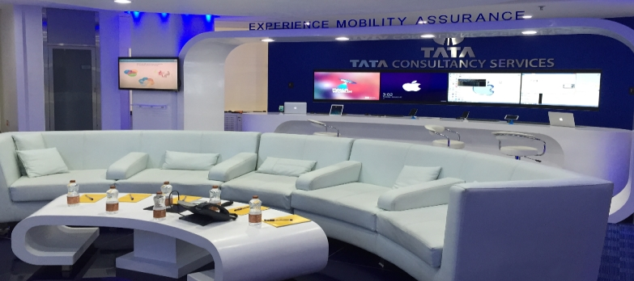















Digital Assurance | Our focus to assure right Customer Experience
Key Offerings to Improve Customer Experience
OMNI
One stop Automation platform for certifying both mobile and browser based applications
iShield
An automated mobile security testing tool and readymade assets
iUserX
Reusable checklists and guidelines for Usability Engineering and Assurance
iAccess
Automated Accessibility Testing Framework (WCAG and 508 Compliance)
State of the art On-Demand Mobility Labs
Industry Alliances & Tools Expertise

